Slide 1


Key Success Factors of Digital Transformation
Vision and Mission
Strategy
KRAs and KPIs
Process Workflow
Business Process Cycle
Instinctual Connect
Measurement
Change Management
Digital Technology
ICT
Moore’s Law
Internet
Data Communication
SMAC
IoT
Software
Tools
Digital Strategy and Process
Digital Mindset & Skills
Disruptive Innovation
Non-disruptive Innvn
Common techniques
Cross-Pollination
Intersection & Fusion
Dare-To-Try
Innovation in DX
Backbone & Empwrmt
Risk-takers
Data-Driven
Customer Obsessed
Tech-savvy
Business-savvy
Agile
Empowered
Adaptable
DIGITAL TRANS-FORMATION
Innovation –Business Models &
Technology
Business Technology Alignment
Cust Interaction stages
Customer Touchpoints
Data Collection
Fm Data to Insights
Fm Insights to Strategy
Customer Life Cycle
Customer centricity
Voice of Customer
Outcome driven
Shared Culture
Strategy alignment
Structure alignment
Process alignment
Drive for Innovation
Aligned Priorities
Tactical alignment
Customer Experience Management
Drive for DATA is embedded in each KSF
© Ashish Pachory

Slide 2

Lecture Series
Technology Drivers of the Digital Enterprise
apachory@iitgoa.ac.in
Ashish Pachory

Slide 3
Visible to the End-User
APPS
EXPERIENCE PLATFORMS
The App is only the tip of the digital iceberg
Social, Gaming, Money, Health, Education. Corporate, SME,
MOBILE WEB PLATFORM
iOS, Android, Windows, HTML5, Web Browser, Middleware
Invisible to the End-User
DIGITAL ENABLERS
SaaS, PaaS, App Developers, Big Data, Analytics
INFORMATION INFRASTRUCTURE
IaaS, Data Centre, Private Cloud, Public Cloud, Data Store
COMMUNICATION INFRASTRUCTURE
HSDN, Cellular, Optical, WiFi, IOT, Internet TCP/IP
TELCO
© Ashish Pachory

Slide 4





Is Moore’s Law enough to drive Digital Transformation?
Aside from Moore’s law the Digital Ecosystem is shaped by advancements in Networking, Software, and Next-Wave IT (SMAC and others)
DIGITAL ENTERPRISE
Apps
Portals
Partnerships
SOFTWARE
NEXT WAVE IT
Cloud Computing
Enterprise Mobility
Social Media Platform
Data Analytics
Business Services (CEM, ERP…)
Application development
Content
Hardware/System Architecture
COMPUTING ARCHITECTURE
In-premise Data Centre
Cloud based Architecture
Security and DR Architecture
Speed
Coverage
Capacity
Speed
Coverage
Capacity
COMMUNICATION NETWORK [HSDN]
© Ashish Pachory

Slide 5
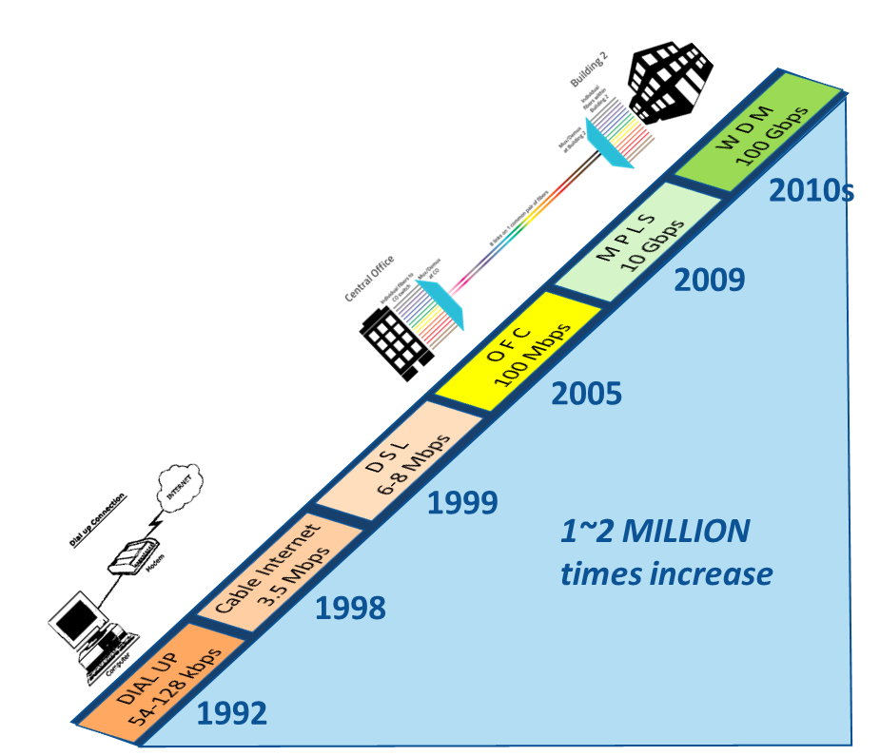
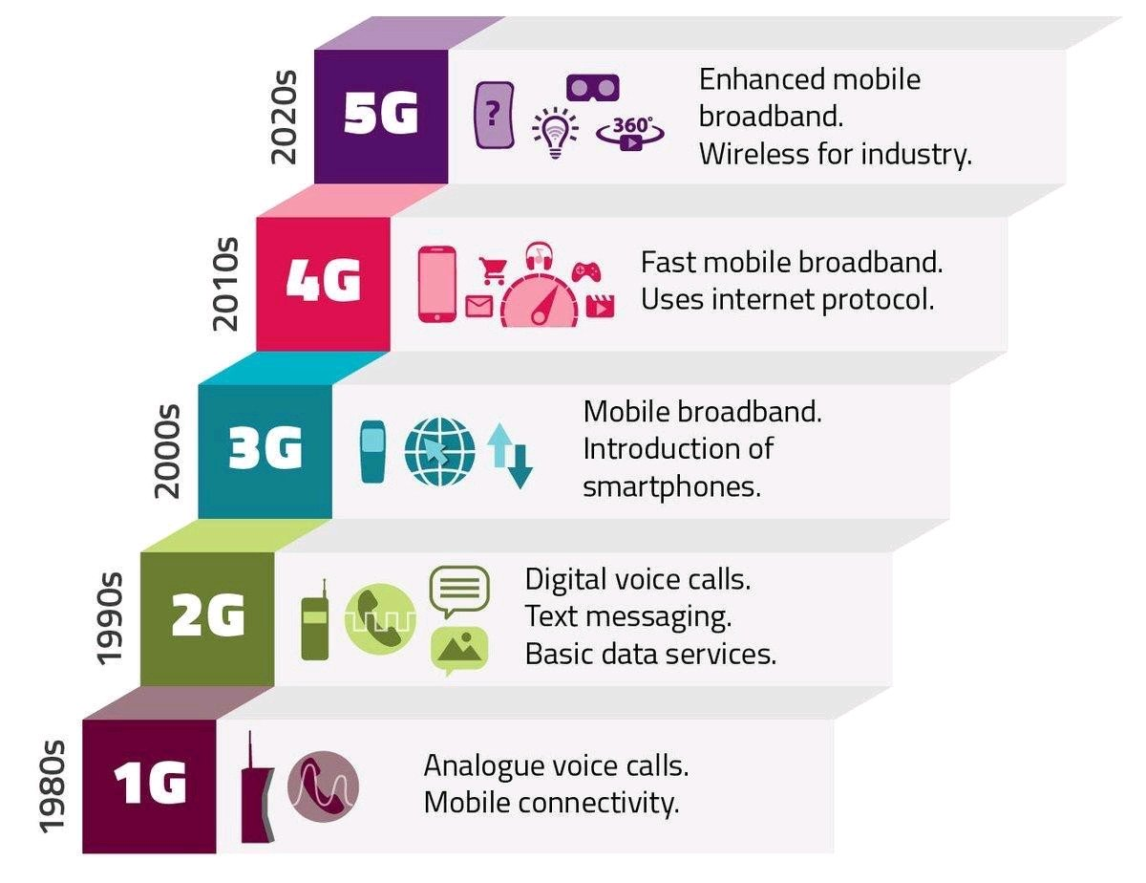
Evolution of Data Networks
CELLULAR DATA
WIRELINE DATA
85 MILLION times increase
20 Gbps 1.5 Secs
1 Gbps 30 secs
How long would it take to download the movie StarWars: The Force Awakens (~4GB)
2 Mbps 4 hrs 15 mins
64 Kbps 5 days 13 hrs
2.4 Kbps 4 months 27 days

Slide 6
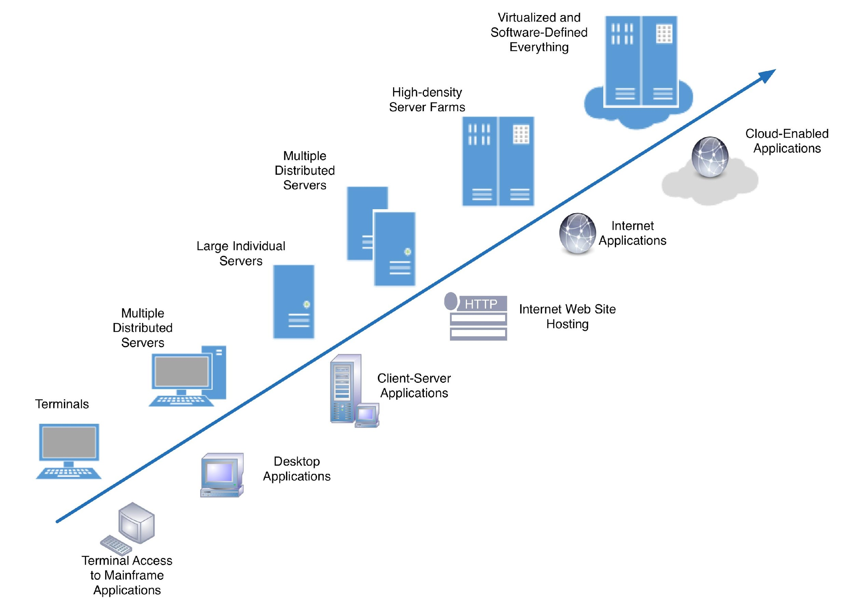
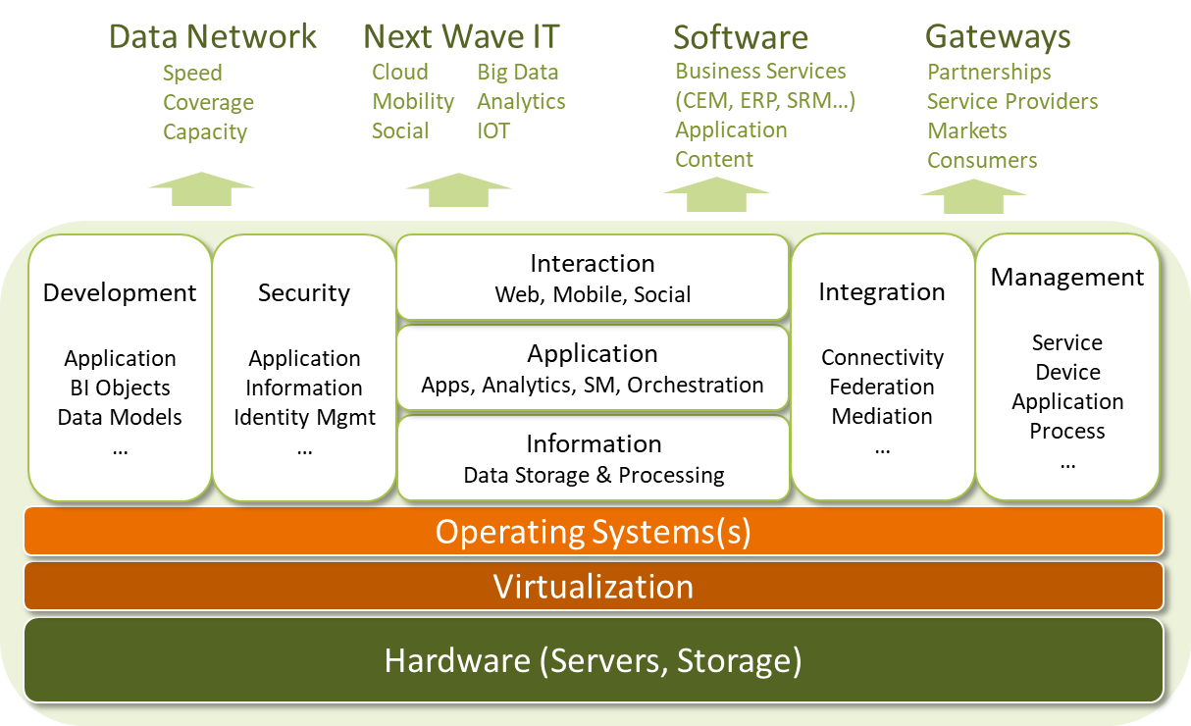
Computing Architecture
Evolution of Hardware Architecture
(Typical) Digital Enterprise Architecture Framework – Agile, Flexible, Future-ready, standards-compliant)
© Ashish Pachory

Slide 7
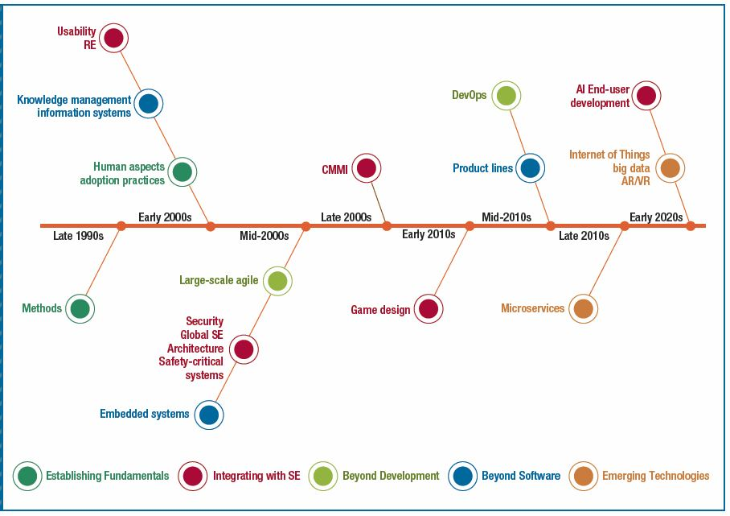
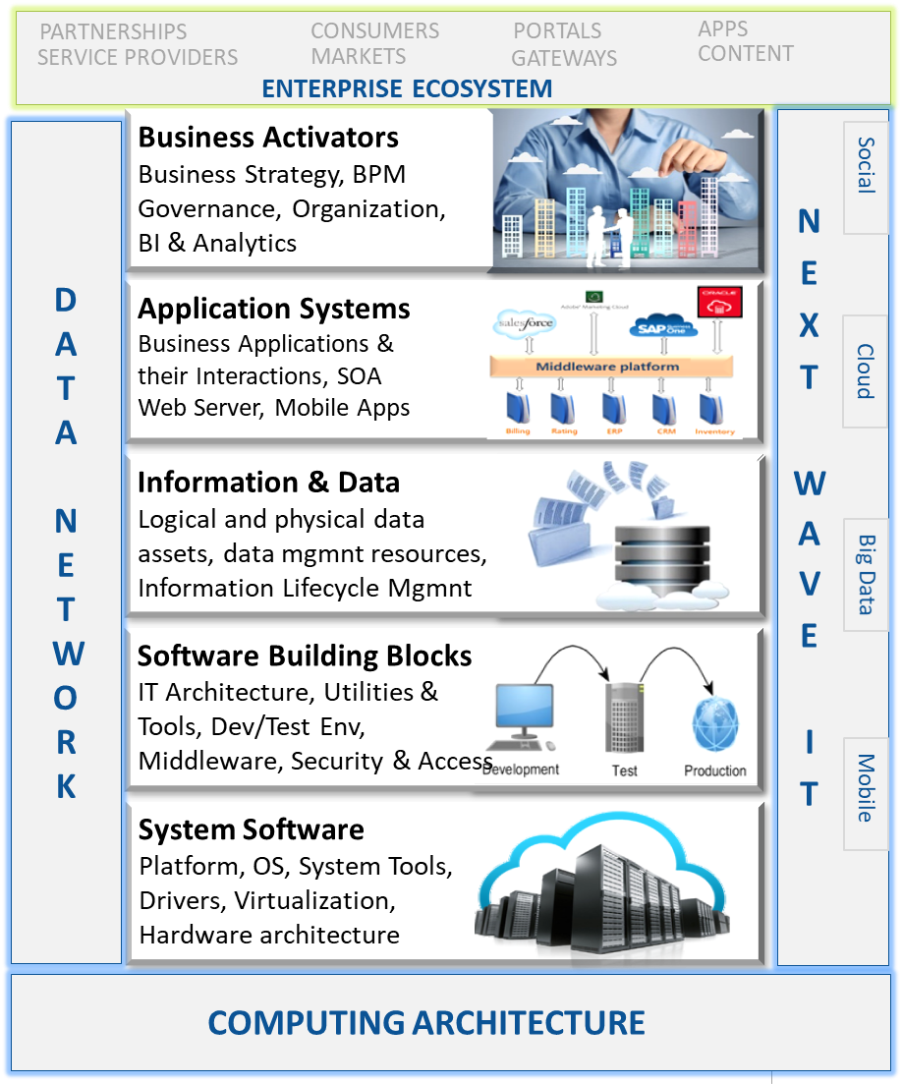
Software

Slide 8

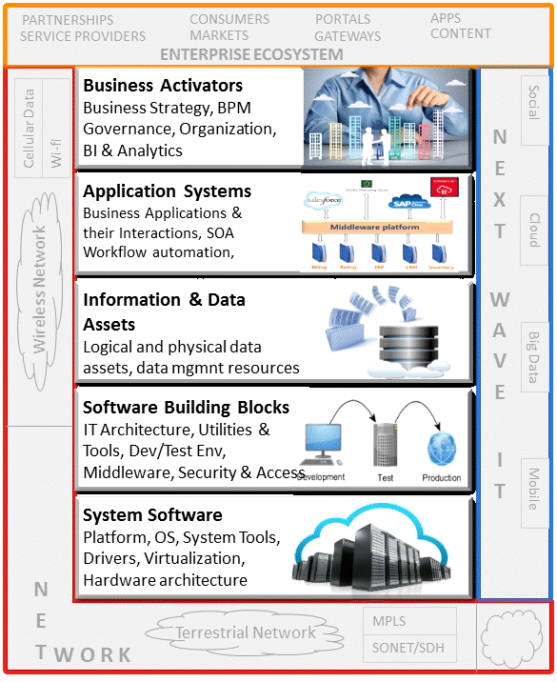

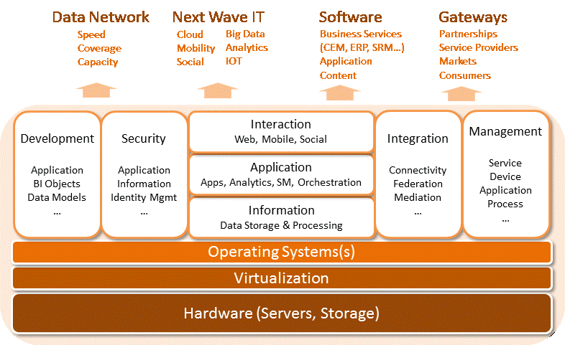


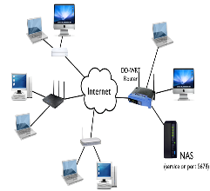
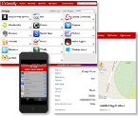
Next-Wave IT
Next Wave IT
Partners
SOFTWARE
Social
Connect
Mobile
Service Providers
Collaborate
COMPUTING ARCHITECURE
DIGITAL ENTERPRISE ECOSYSTEM
Analytics
Consumers
Liberate
Cloud
Markets
DATA NETWORK
Empower
<Future>
Apps, Portals, Developers

